Slide 1
Music recommender system
Using word2vec and collaborative filtering
BY:Tanmay Mathur

Slide 2
agenda
Introduction
Data Description
Algorithms
Results
Future Work

Slide 3
INTRODUCTION
Project Goal : To provide quality music recommendations to user
Data : Usage data from lastfm
Algorithms : word2vec (word embeddings) , Collaborative Filtering (ALS Implicit)
Technology Stack : Spark(Scala), Python (Gensim, Pandas) , ggplot (Visualization)

Slide 4
Data description
Lastfm data : http://www.dtic.upf.edu/~ocelma/MusicRecommendationDataset/lastfm-1K.html
Data Format : userid \t timestamp \t musicbrainz-artist-id \t artist-name \t musicbrainz-track-id \t track-name
Total Events : 4413912
Users : 992
Tracks : 1084873

Slide 5
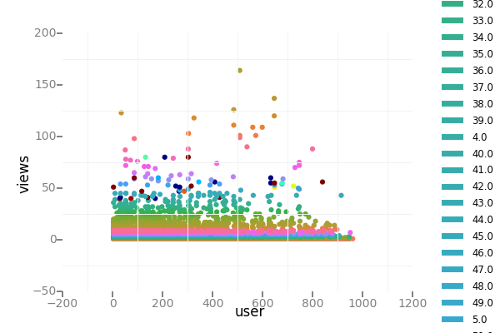
USERS, views and product graph

Slide 6
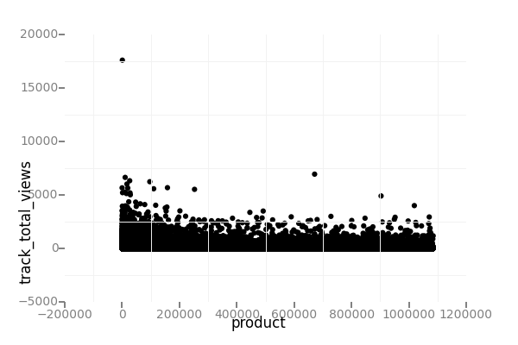
Songs and total views

Slide 7
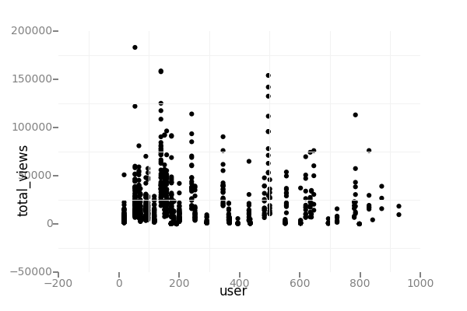
User activity

Slide 8
ALGORITHM
Word Embeddings
Introduced by Bengio a decade ago
W: words→R^{n} is a paramaterized function mapping words in some language to high-dimensional vectors

Slide 9
GENERATING RECOMMENDATIONS FROM word2vec
Find similar tracks to personalized recommendations based on usage data
Depending on the user mood, they can listen to similar songs in a sequence
Word2Vec requires an input sentence
We create artificial sentences using the sequence in which users viewed the track
Song sequences are created using a window of 30 minutes for every user
Use Gensim default configuration to train the word2vec model
Output is a 200 dimensional vector for all tracks

Slide 10
COLLABORATIVE FILTERING USING ALS Implicit
Commonly used for building recommender systems
Needs userId, productId and ratings as input to standard matrix factorization approach based collaborative filtering
Real-world use cases have only implicit feedbacks(clicks, likes, shares, retweets etc.)
ALS Implicit treats the implicit feedbacks as strength of observation
The model finds latent features that is used to predict the expected preference of a user for an item

Slide 11
FINAL ALGORITHM
Find candidates using collaborative filtering for a user
Use the returned candidate list to look for most similar items using the word2vec model
Return N candidates to the user, where N = [M,K]
Different arrangements could be evaluated against user feedback in a live system

Slide 12
Results
The best model was trained with rank = 12 and lambda = 0.1, and numIter = 10, and its RMSE on the test set is 10.764309205205556.
The test mean squared error is = 10.764309205205556

Slide 13
ALGORITHM OUTPUT
Songs recommended for you:
1: Neighborhood #3 (Power Out)
2: Rebellion (Lies)
3: Keep The Car Running
4: Untitled
5: Such Great Heights
6: Neighborhood #1 (Tunnels)
7: Karma Police
8: Heartbeats
9: Neighborhood #2 (Laika)
10: Une Année Sans Lumière
11: Neighborhood #2 (Laika)
12 : Crown Of Love
13: Une Année Sans Lumière

Slide 14
FUTure work
Change the window size and tune the model
Take season, and times(Mornings, Afternoon, Evenings, Night) in to consideration.

Slide 15
QUESTIONS?

